Slide 1
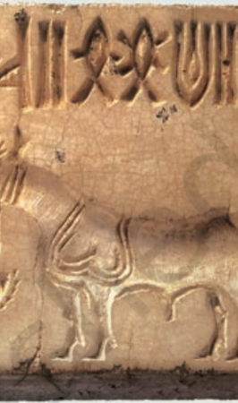
class XII-HISTORY
Lesson 1
Bricks, Beads and Bones (The Harappan civilisation)

Slide 2
part 1
TOPICS COVERED
1.Beginnings
2.Subsistence Strategies
3.Mohenjodaro (A Planned Urban Centre)
4.Tracking Social Differences
5.Finding About Craft Production
6.Strategies for Procuring Materials

Slide 3
1.Beginnings(3300-1300 B.C.E)
Harappan
Civilisation
Discovered in 20th century
Early phase
Before 2600 B.C.E
Mature Phase
2600-1900 B.C.E
Late Phase
after1900B.C.E

Slide 4
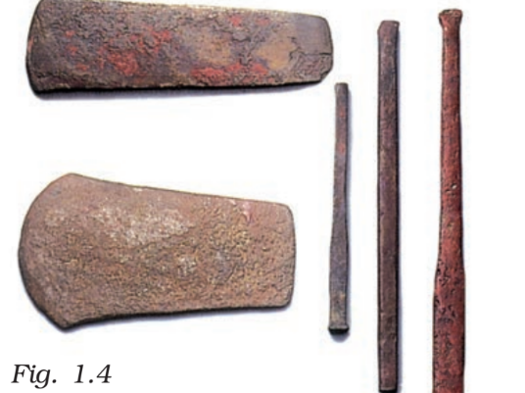
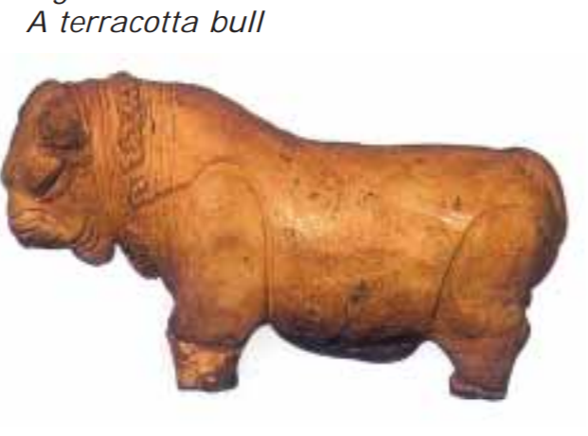
2.Subsistence Strategies
Animal and Plant products
Domestication of animals
Prevalence of agriculture(agricultural technology)
Evidence of grains
Representation of seals
Sculptures (terracotta sculpture of bull and oxen)
Models of plough
Evidence of ploughed fields (kalibangan)
Irrigation System (Canals in Shortugha and water reservoirs in Dholavira)

Slide 5
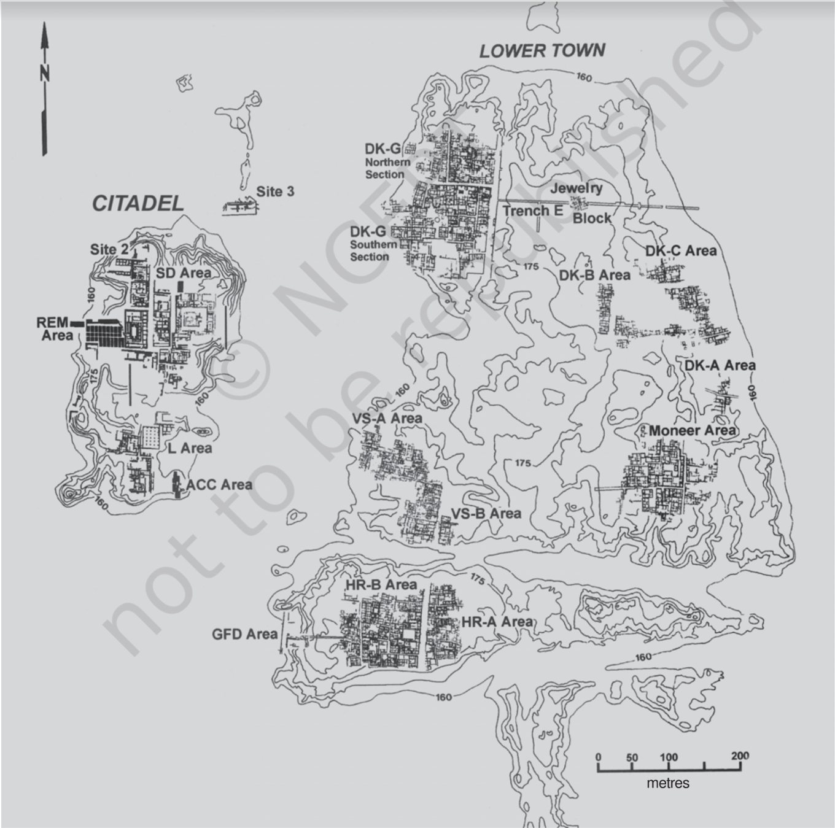
3.Mohenjodaro (A Planned Urban Centre)
Planned Urban Centre (Discovered in 1920s)
One of the largest settlements
Two sections : Citadel and lower sections
Drainage system (carefully planned, grid system )
Domestic architecture (courtyard, concerned for privacy)
Citadel
Warehouse and Great bath
Bricks (Length=4 x height , Breadth= 2 x height)

Slide 6
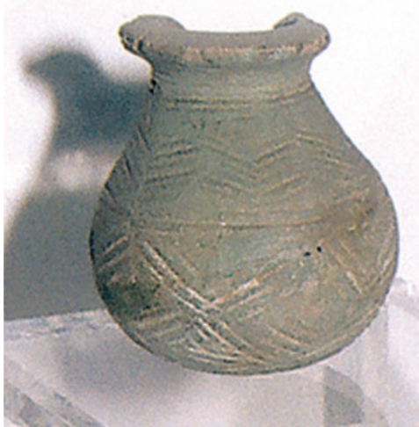
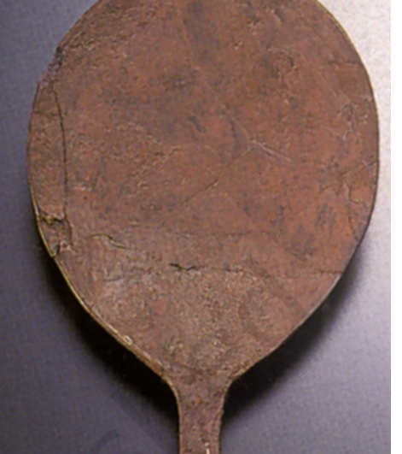
4.Tracking Social Differences
Studying Burials
Structure and artefacts
Studying Artefacts
Luxurious items (precious stones, jewellery etc.)
Utilitarians (pots, vessels , baskets etc.)

Slide 7
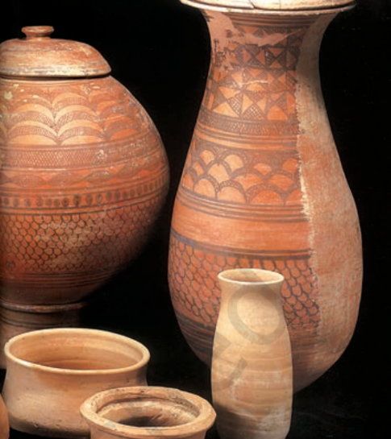
5.Finding About Craft Production
Activities (chanhudaro)
Materials used
Technique(steatites, geometrical shapes)
Identifying centres (Nageshwar, Balakot)
Finding raw materials, rejected materials, unfinished
and finished materials.

Slide 8
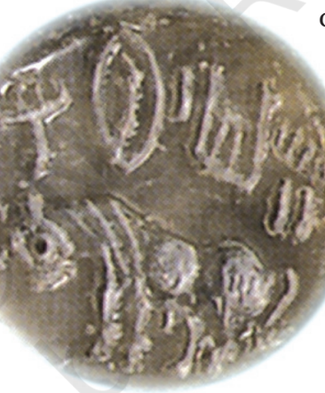
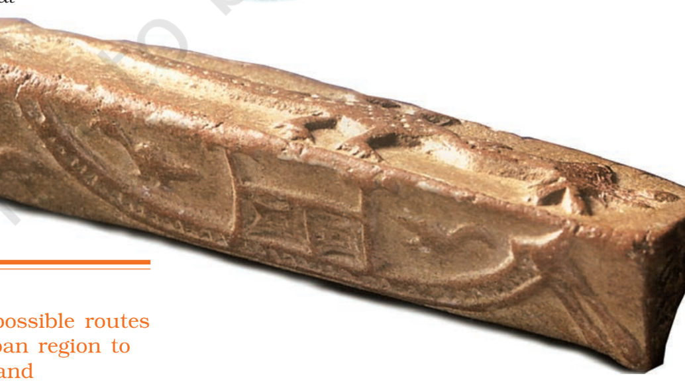
6.Strategies for Procuring Materials
Materials from subcontinent and beyond
Localy available(terracotta model of bullock carts )
Expedition
Contact with distinct lands
Evidence from Mesopotamian texts(magan{Oman}, Dilmun{Bahrain}, meluhha)
Copper from Oman
Evidence of ships and boats on seals

Slide 9
Part 2
Topics Covered
Seals, scripts, weights
Ancient Authority
The End of the civilisation
Discovering the harappan civilisation
Problems of piecing together the past

Slide 10
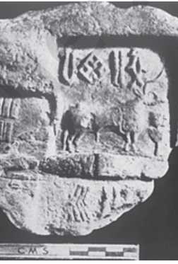
Seals, scripts, weights
Seals, sealings(it is a device used for closing and opening of materials and documents)
It is also used for authenticity of a particular document and also facilitates long distance communications
The Harappan seals contains the name and title of the owner
There were motifs of animals which were imprinted for the people who couldn’t read so images of animals were imprinted on the seal.
Harappan scripts were anigmated which means that it was difficult to understand the script even today is undeciphered.
The scripts were not alphabetical
There were too many pictures and symbols
Almost 375 – 400 symbols
Scripts were written from right to left
The evidence of Harappan writing In seals, jewellery and lids of jars.
There was precise system of weights
Weights were made of stone called Chert
They were cubical in shape
It was suggested that smaller weights were used for jewellery, precious stones, beads etc.
There were evidences of metal scale pan.

Slide 11
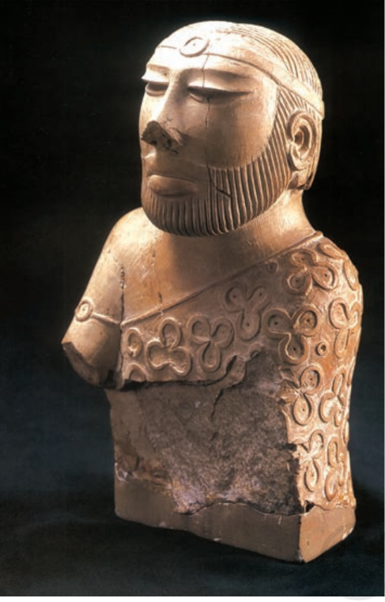
Ancient Authority
Political system
It was assumed by the archaeologists that there were existence of a political system.
A large building found at Mohenjodaro was labelled as a palace by archaeologists but no spectacular finds were associated with it.
A stone statue was labelled and continues to be known as the “priest-king”.
Different opinions of archaeologists –
one set of archaeologists believed that there was no ruler at all
Another set of archaeologists believed that there were several rulers in the society
In the third set of opinion it was believed that there was a single ruler and it was the most possible theory we believe because evidence show a single statue of the priest king as we can see in the picture

Slide 12
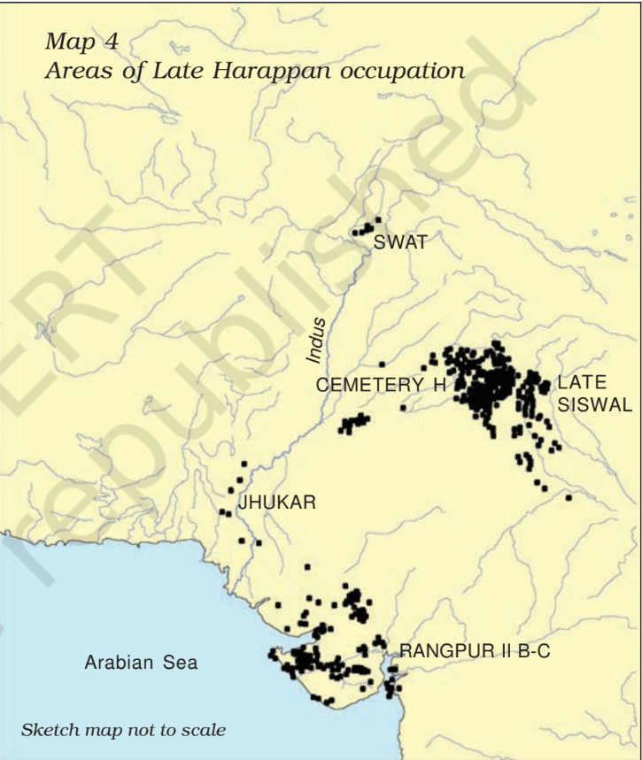
The end of the civilisation
Evidence of mature phase started from 1900 B.C.E
Sites like Cholistan had been abandoned.
People left these towns and started moving towards western Rajasthan,Gujarat, Haryana etc.
Slowly everything was disappearing like artefacts, seals, weights and even writings of trades.
Even house constructions became detoriating.
Causes of decline of the civilisation:-
Climate change
Deforestation
Excessive floods
Drying up of rivers
Overuse of landscape
Economic and political detoriations.

Slide 13
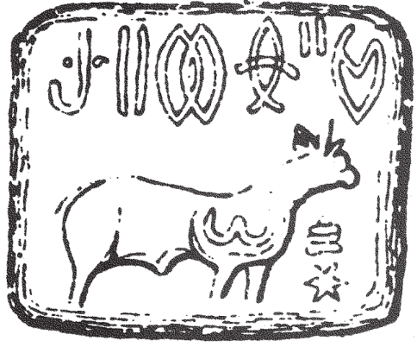
Discovering the harappan civilisation
ASI( Archaeological Survey of India , founded in 1861)
First director of ASI was Alexander Cunningham
He relied on written words than on artefacts like inscriptions, accounts and texts.
Indian archaeologists like Dayaram Sahani got evidence of seals in Harappa and R.D Banerjee found seals at Mohenjodaro
In 1924, John Marshall announced the discovered of a new civilisation which is the Indus Valley civilisation
Archaeologists are using modern scientific techniques including surface exploration to recover traces of clay, stone, metal and plant and animal remains.
After the partition, major sites of harappan civilisation went into Pakistan. Due to this Indian Archaelogists tried to find out some new sites some of which are in Rajasthan, Lothal, Rakhigari, Dholavira etc.
From 1980s international Archaeologists participated in thus project and scientific techniques were used by them.
So, the process of rediscovering this civilisation is still taking place.

Slide 14
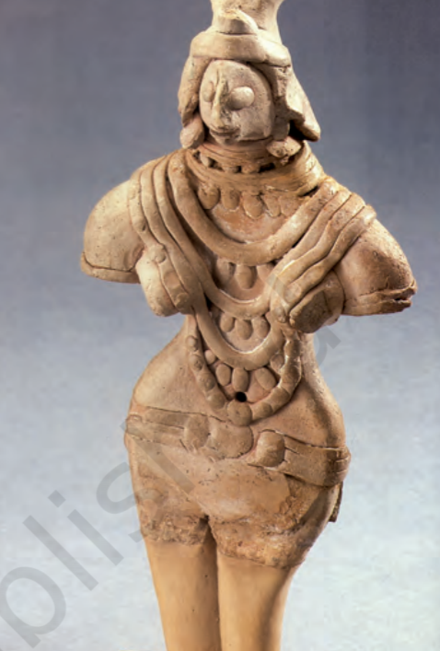
Problems of piecing together the past
As Harappan script was enigmatic so, it is material evidence that allows archaeologists to better reconstruct Harappan life.
Classification of artefacts
Material – it is easy work
Function – complex work
Resemblence with present day things
Depiction in sculpture
Sometimes, archaeologists have to take recourse to indirect evidence. For instance, though there are traces of cotton at some Harappan sites, to find out about clothing we have to depend on indirect evidence including depictions in sculpture.
Reconstruction of religious practice
Attempts have also been made to reconstruct religious beliefs and practices by examining seals, some of which seem to depict ritual scenes.
Several reconstructions remain speculative at present.

